Slide 1
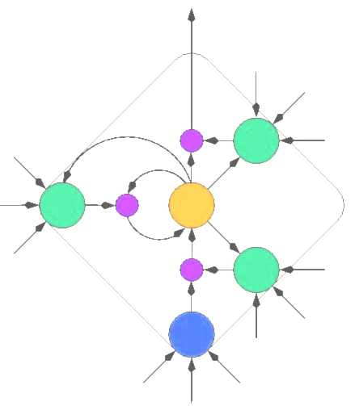
Neural Networks
(Jaringan Syaraf Tiruan) by:
Greg

Slide 2
What are neural networks?
“… systems that are deliberately constructed to make use of some of the organizational principles that are felt to be used in the human brain.” — Anderson
“... a neural network is a system composed of many simple processing elements operating in parallel whose function is determined by network structure, connection strengths, and the processing performed at computing elements or nodes.” — DARPA Neural Network Study (1988)
“A Neural Network is an interconnected assembly of simple processing elements, units or nodes, whose functionality is loosely based on the animal neuron. The processing ability of the network is stored in the inter-unit connection strengths, or weights, obtained by a process of adaptation to, or learning from, a set of training patterns.” — Gurney

Slide 3
Motivations
Humans have always wanted to build intelligent machines — stories of golems, automata, mechanical men, and robots have been around for millenia
Computer technology is rapidly approaching the processing power of human brains
  But organization and function (if the human brain) are still huge unknowns
Biological brains use neurons that are 10⁵ or 10⁶ times slower than silicon logic gates, yet perform computations better and faster than our best computational algorithms
(Artificial) Neural Networks are an attempt to harness the massively parallel, distributed computation of biological brains for a variety of purposes

Slide 4
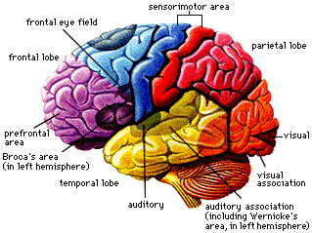
What’s our motivation?
Science: Model how biological neural systems, like human brain, work?
How do we see?
How is information stored in/retrieved from memory?
How do you learn to not to touch fire?
How do your eyes adapt to the amount of light in the environment?
Related fields: Neuroscience, Computational Neuroscience, Psychology, Psychophysiology, Cognitive Science, Medicine, Math, Physics.

Slide 5

What’s our motivation?
Engineering: Design information processing systems that are as good as the biological ones?
How can we design a vision system that can see?
how can we store data such that it can be retrieved fast?
How can we make a robot not to repeat an action that “burned” it before?
How can we make an articial retina that automatically adapts to the mount of light?
Related fields: Computer Science, Statistics, Electronics Engineering, Mechanical Engineering.

Slide 6

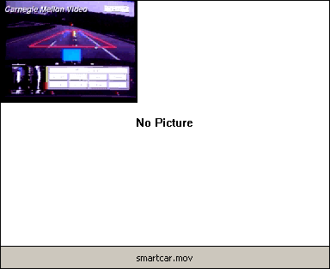

ALVINN drives 70mph on highways

Slide 7
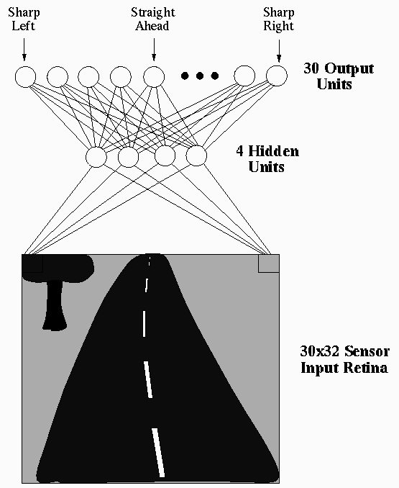
ALVINN drives 70mph on highways

Slide 8
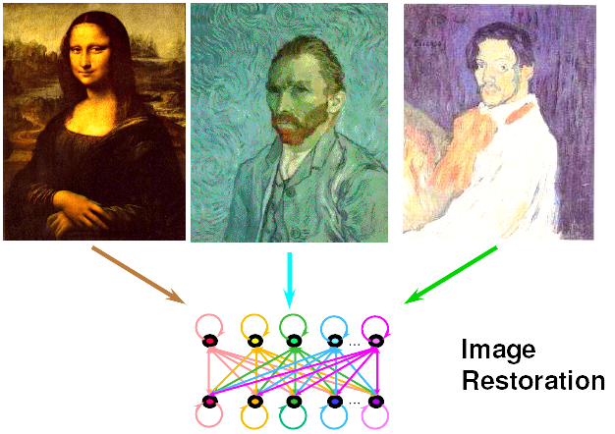
Robust Pattern Recognition & Image Restoration

Slide 9
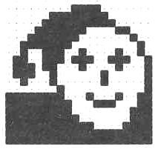
Image Restoration
Example: Image reconstruction (Ritter, Schulten, Martinetz 1990)
A 20×20 discrete Hopfield network was trained with 20 input patterns, including the one shown in the figure.

Slide 10
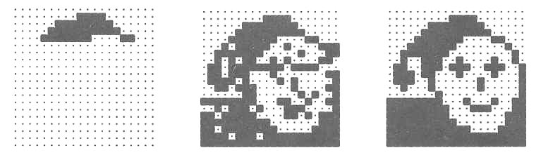
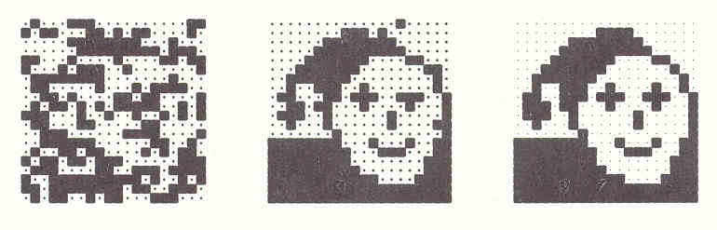
Image Restoration

Slide 11
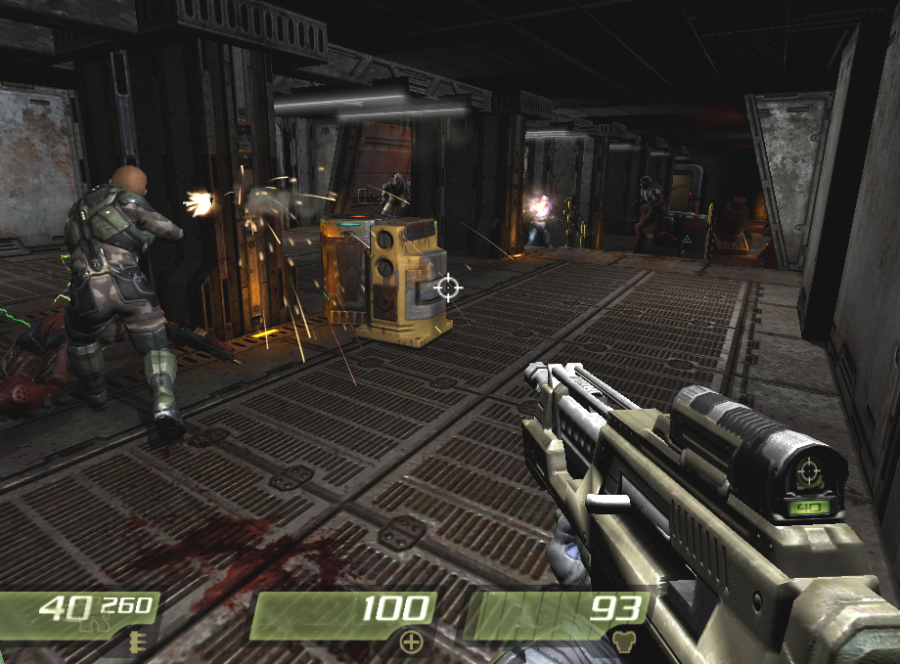

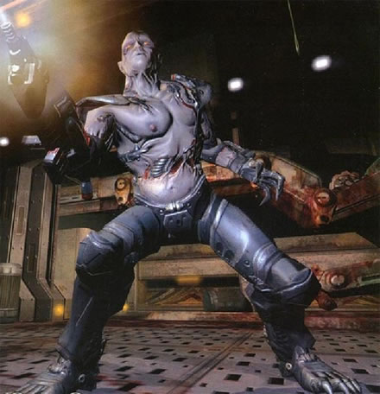


Game Playing
Chase
Retreat
Spawn
Wander
Attack
Low Health
Sound
Dead
Enemy

Slide 12
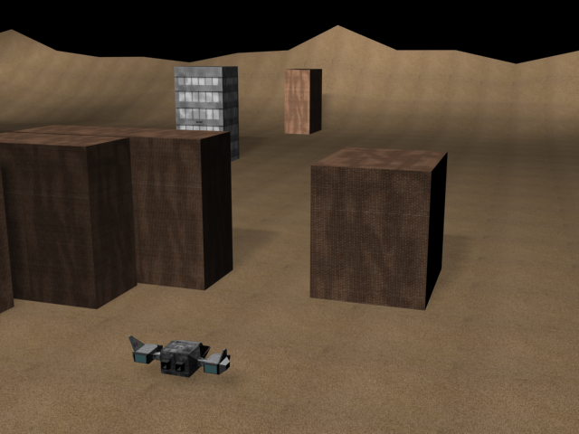
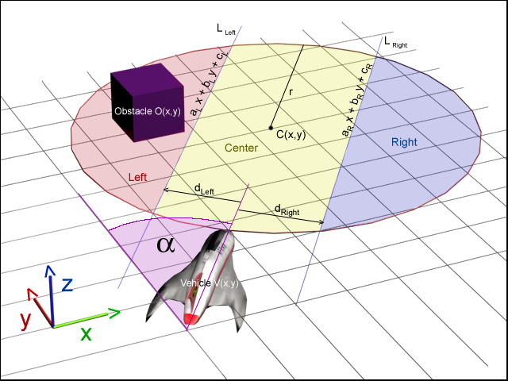
Virtual Vehicle Control
Input:

Slide 13
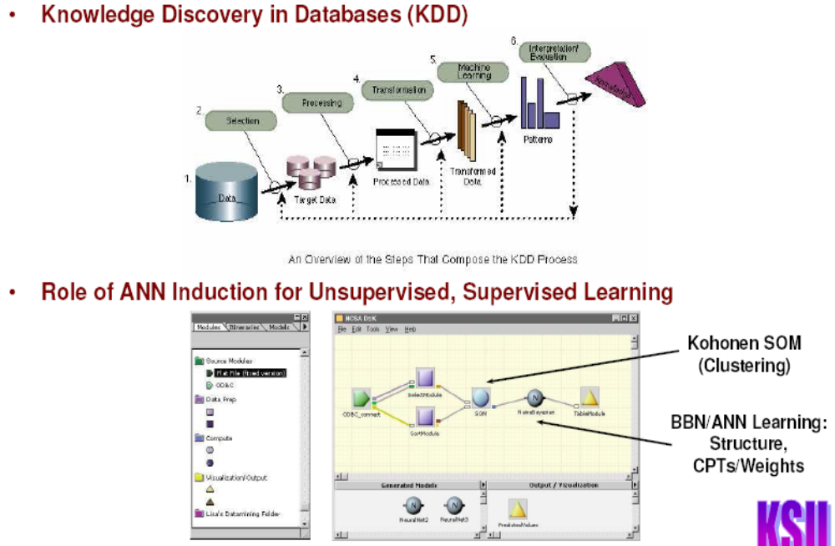
Data Mining Application

Slide 14
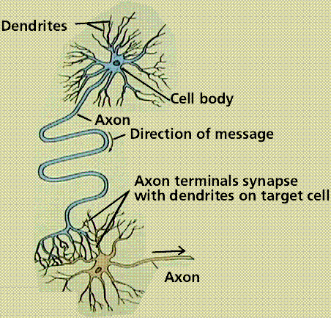
The biological neuron - simplified
The basic information processing element of neural systems. The Neuron:
receives input signals generated by other neurons through its dendrites,
integrates these signals in its body,
then generates its own signal (a series of electric pulses) that travel along the axon which in turn makes contacts with dendrites of other neurons.
The points of contact between neurons are called synapses.

Slide 15
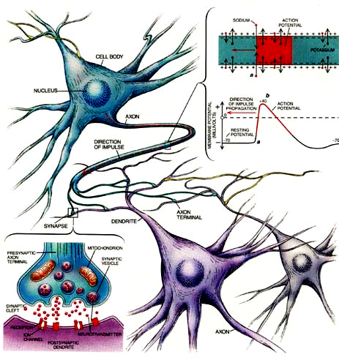
The biological neuron - 1
The pulses generated by the neuron travels along the axon as an electrical wave.
Once these pulses reach the synapses at the end of the axon open up chemical vesicles exciting the other neuron.

Slide 16
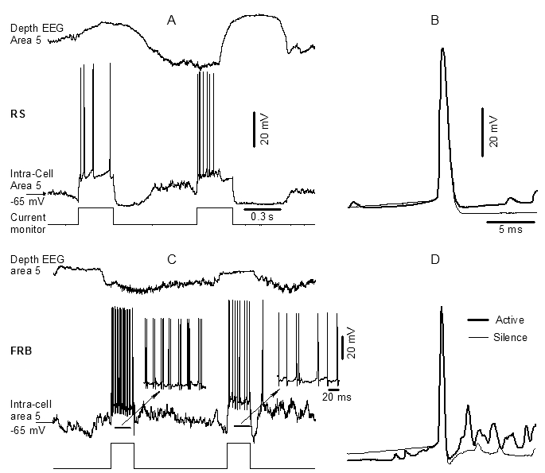
How do neurons propagate signals?
Neurons normally have a negative resting potential of about -65mv to -80mv, with a negative cytoplasm and positive ions lining the cell membrane (K+ inside, Na+ out).
Neurotransmitters emitted from the presynaptic terminal drive positive ion uptake (extracellular K⁺) into the postsynaptic cell, making its membrane potential less negative, until the postsynaptic neuron reaches a threshold and fires its action potential—a faster influx of positive ions (Na⁺) that sweeps along the cell membrane, temporarily driving the cell to have a positive membrane potential.
This action potential causes the cell to emit its own neurotransmitters, thus propagating the electrical signal.
At the height of the membrane potential reversal, a rapid efflux of K⁺ occurs, returning the cell to is negative polarization.
Finally sodium-potassium pumps work continuously to restore the balance of K⁺ and Na⁺ along the cell membrane.

Slide 17
How big is a human brain?
10¹⁰ to 10¹¹ neurons (10 to 100 billion)
10² to 10⁴ synapses per neuron (100 to 10 thousand), 10¹² to 10¹⁵ synapses total.
10¹¹ neurons and 10¹⁴ synapses are probably reasonable values.
Note:
  3 Years Ago (2009), ±10⁹ transistors on a chip.
  2 Years Ago (2010), ±10¹⁰ transistors on a chip.
  Tomorrow???

Slide 18
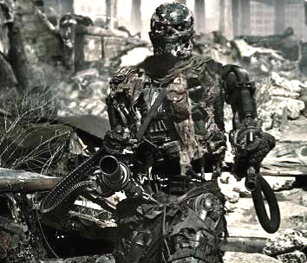
How big is a human brain?

Slide 19
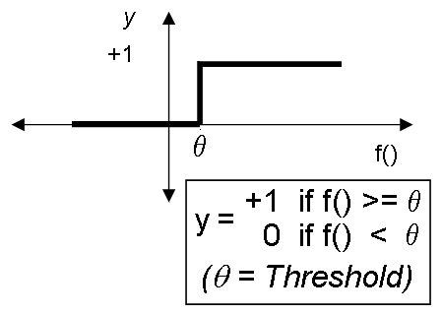
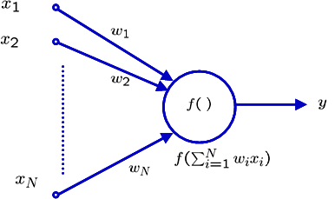
McCulloch-Pitts neuron model (1943)
f() is called the activation function.
x₁, x₂ … x_{N} are the inputs at time t-1.
Inputs are binary.
At each interval the neuron can fire at most once.
Positive weights (w_{i}) correspond to excitatory synapses and negative weights correspond to inhibitory synapses.
θ is the threshold for the neuron to fire.
f() is a non-linear hard-limiting function in the original McCulloch-Pitts model.
No learning mechanism!
Later f() is replaced by other continuous squashing functions.

Slide 20
Boolean AND
X1 | X2 | Y
0 | 0 | 0
0 | 1 | 0
1 | 0 | 0
1 | 1 | 1
Threshold
θ = 2
W₁ = 1
W₂ = 1
x₁
x₂
X1 | X2 | f(y) | Y
0 | 0 | 0 | 0
0 | 1 | 1 | 0
1 | 0 | 1 | 0
1 | 1 | 2 | 1

Slide 21
Boolean OR
X1 | X2 | Y
0 | 0 | 0
0 | 1 | 1
1 | 0 | 1
1 | 1 | 1
Threshold
θ = 2
W₁ = 2
W₂ = 2
x₁
x₂
X1 | X2 | f(y) | Y
0 | 0 | 0 | 0
0 | 1 | 2 | 1
1 | 0 | 2 | 1
1 | 1 | 4 | 1

Slide 22
Inverter
X1 | Y
0 | 1
1 | 0
Threshold
θ = 2
w₂= 2
X₂ = 1
w₁= −1
x₁
X1 | X2 | f() | Y
0 | 1 | 2 | 1
1 | 1 | 1 | 0

Slide 23
Boolean XOR
X1 | X2 | Y
0 | 0 | 0
0 | 1 | 1
1 | 0 | 1
1 | 1 | 0
How???
x₁
x₂

Slide 24
Linear Separability
x₂
+
+
OR
x₂
−
+
x₁
−
+
x₂
AND
?
x₁
−
−
+
−
XOR
x₁
−
+

Slide 25
History of neural networks
Alexander Bain (1873), Scottish inventor of the first electrical clock and the “chemical telegraph” (fax machine), published Mind and Body: The Theories of Their Relation, proposing networks of artificial neurons that used a Hebb-like adaptive rule to produce associations for inputs that are “made together, or flow in close succession”
  In 1876 he founded the first psychological journal entitled Mind
William James (1890), American psychologist, published Principles of Psychology,
  “Mental facts cannot properly be studied apart from the physical environment of which they take cognizance”
  “When two elementary brain-processes have been active together or in immediate succession, one of them, on reoccurring, tends to propagate its excitement into the other.“
Nicolas Rashevsky (1938), in addition to early work on a statistical theory of neural fields, proposed the first neural logic circuit in 1938 with an EXCLUSIVE-OR network based on binary logic, and proposed that the brain could be organized around binary logic operations, since the action potential could be seen as a binary operator

Slide 26
History of neural networks
Warren McCulloch (a psychiatrist and neuroanatomist) and Walter Pitts (a mathematician) (1943), started the modern era of neural networks when they proposed a neuron model that summed its inputs and fired whenever that sum exceeded a threshold
  Using a network of such threshold neurons they showed it was possible to construct any logical function
Donald Hebb (1949), published The Organization of Behavior, in which he proposed that the effectiveness of a synapse between two neurons might be increased by correlated activity of those two neurons
  Used widely in artificial neural models today
  There is also evidence of a biological mechanism in which neural activity modulates calcium ion flow, which, in turn, affects the physical structure of synapses
Farley and Clark (1954), on an early digital computer at MIT, modeled a network of randomly connected neurons employing a modified Hebb learning rule that was able to learn to discriminate between two input patterns

Slide 27
History of neural networks
Frank Rosenblatt (1958), introduced the single-layer perceptron with adjustable synaptic weights and a threshold output neuron
  Rosenblatt conceptualized perceptrons as consisting of three layers, for sensory, association, and response.
  He also introduced an error-correction rule (the perceptron learning rule) to adapt the weights (the perceptron convergence algorithm).
Bernard Widrow and Ted Hoff (1960), introduced the Least-Mean-Squares algorithm (delta-rule or Widrow-Hoff rule) and used it to train ADALINE (ADAptive LINear Elements or ADAptive LInear NEurons)
  ADALINE was similar to a perceptron, except for using a linear activation function instead of a threshold
  MADALINE (Multiple ADALINE) used multiple ADALINE units, still in a single conceptual layer, and combined their outputs in a fixed way (AND, OR, majority vote takers)
  MADALINE and the delta-rule were used to eliminate echo in phone lines in the first practical application of ANNs, and they are still used today in telecommunications

Slide 28
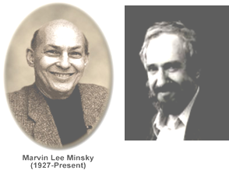
History of neural networks
(The Enemy)
Marvin Minsky and Seymour Papert (1969), published Perceptrons, in which they mathematically proved that single-layer perceptrons were only able to distinguish linearly separable classes of patterns
  While true, they also (mistakenly) speculated that an extension to multiple layers would lose the “virtue” of the perceptron’s simplicity and be otherwise “sterile”.
In the 1950s to 1960s, symbolic AI and sub-symbolic Connectionism competed for prestige and funding
  AI investigated higher-order cognitive problems—logic, rational thought, problem solving
  Connectionism investigated neural models like the perceptron and struggled to find a learning algorithm for multi-layer perceptrons
  As a result of Minsky & Papert’s Perceptrons, research in neural networks was effectively abandoned in the 1970s to early 1980s
Boolean XOR
How???
x₁
x₂

Slide 29
History of neural networks
(The Dark Age)
Shun-ichi Amari (1967), and Christoph von der Malsburgh (1973), published ANN models of self-organizing maps, but the work was largely ignored.
Paul Werbos (1974), in his PhD thesis, first demonstrated a method for training multi-layer perceptrons, essentially identical to Backprop but the work was largely ignored.
Stephen Grossberg and Gail Carpenter (1980), established a new principle of self-organization called Adaptive Resonance Theory (ART), largely ignored at the time.
David Parker (1982), published an algorithm similar to Backprop, which was ignored.

Slide 30
History of neural networks
John Hopfield (1982), described a class of recurrent networks as an associative memory using statistical mechanics; now known as Hopfield networks,
Teuvo Kohonen (1982), introduced SOM algorithms for Self-Organized Maps, that continue to be explored and extended today
Kirkpatrick, Gelatt and Vecchi (1983), introduced Simulated Annealing for solving combinatorial optimization problems
Barto, Sutton, and Anderson (1983), popularized reinforcement learning (it had been addressed briefly by Minsky in his 1954 PhD dissertation)
Valentino Braitenberg (1984), published Vehicles, in which he advocates for a bottom-up, synthesis approach to understanding complex systems, and bases his mental models on neurophysiological data.
Yann Le Cun (1985), published an algorithm similar to Backprop, which was again ignored

Slide 31
History of neural networks
David Ackley, Geoffrey Hinton, and Terrence Sejnowski (1985), introduced the Boltzmann machine (the first successful realization of a multilayered neural network)
David Rumelhart, Geoffrey Hinton, and Christopher Williams (1986), introduced Backprop, the first widely recognized learning algorithm for multilayer perceptrons or neural networks
  Hopfield and Backprop are considered most responsible for the rebirth of neural networks
David Rumelhart, James (Jay) McClelland (1986), and the PDP Research Group, published Parallel Distributed Processing: Explorations in the Microstructure of Cognition, Volumes 1 and 2, and officially resuscitated neural network research
Terrence Sejnowski and Charles Rosenberg (1986), introduced NETtalk, a text-to-speech neural network system trained using Backprop, and one of the earliest practical applications of multilayer perceptrons
In 1987 NIPS, INNS, IJCNN neural network conferences began.

Slide 32
McCulloch-Pitts
McCulloch-Pitts (1943): The first computational neuron model.
Showed that networks made from these neurons can implement logic functions, such as AND, OR, XOR. Therefore these networks are universal computation devices.
Assumptions made:
Neuron activation is binary.
At least a certain number of excitatory inputs are needed to excite the neuron.
Even a single inhibitory input can inhibit the neuron.
No delay.
Network structure is fixed.
No adaptation!

Slide 33
Boolean XOR
McCulloch-Pitts Net ( 2 layer )
X₁
2
Z₁
Threshold
θ = 2
-1
2
Y
XOR
-1
X₂
Z₂
2
2
X1 | X2 | f(z1) | f(z2) | Z1 | Z2 | f(y) | Y
0 | 0 | 0 | 0 | 0 | 0 | 0 | 0
0 | 1 | -1 | 2 | 0 | 1 | 2 | 1
1 | 0 | 2 | -1 | 1 | 0 | 2 | 1
1 | 1 | 1 | 1 | 0 | 0 | 0 | 0

Slide 34
McCulloch-Pitts Neuron (C++ Code)
int x1, x2, y;
float w1, w2, T;
main(){
  printf(“weight 1 = “); scanf(“%f”, &w1);
  printf(“weight 2 = “); scanf(“%f”, &w2);
  printf(“Threshold = “); scanf(“%f”, &T);
  printf(“ X1 X2 Output\n”);
  for(x1 = 0; x1 < 2; x1++)
  for(x2 = 0; x2 < 2; x2++){
  y = ((w1 * x1 + w2 * x2) >= T);
  printf(“ %d %d %d\n”,x1,x2,y);
  }
}

Slide 35
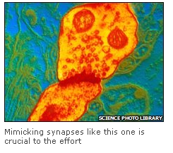
Large IBM investment in the next generation of Neural Nets
IBM plans 'brain-like' computers
Page last updated at 14:52 GMT, Friday, 21 November 2008
By Jason Palmer
Science and technology reporter, BBC News
IBM has announced it will lead a US
government-funded collaboration to
make electronic circuits that mimic
brains.
http://news.bbc.co.uk/2/hi/science/nature/7740484.stm

